Slide 1
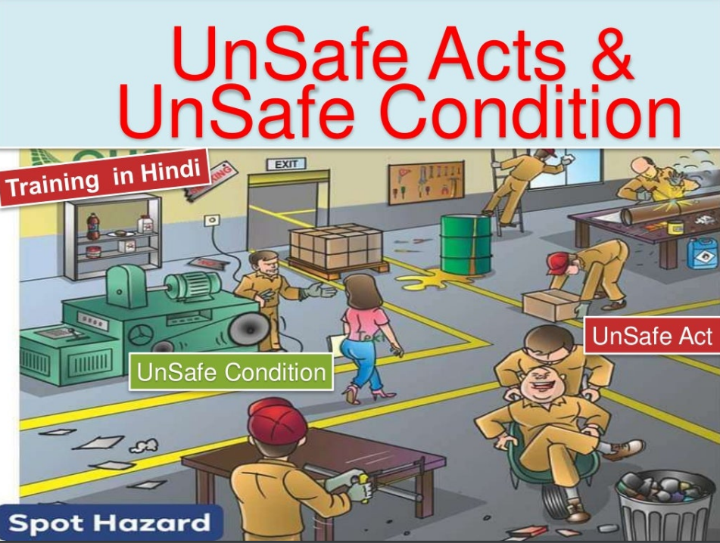

Slide 2
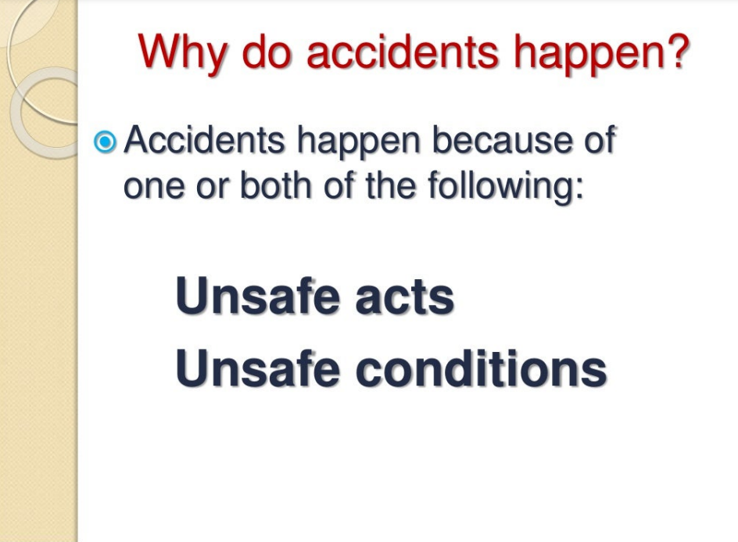

Slide 3
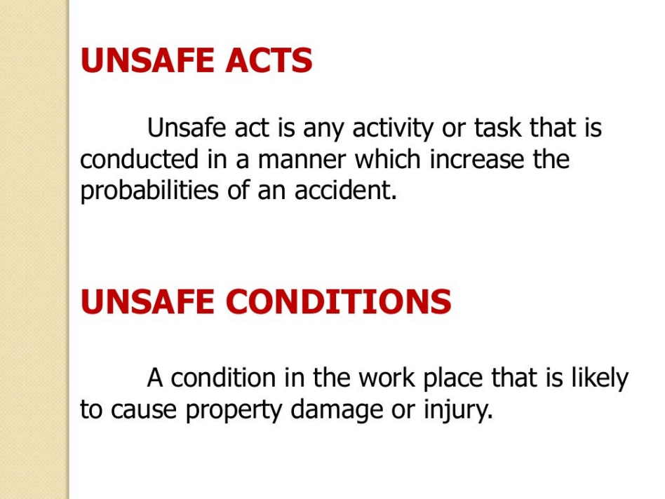

Slide 4
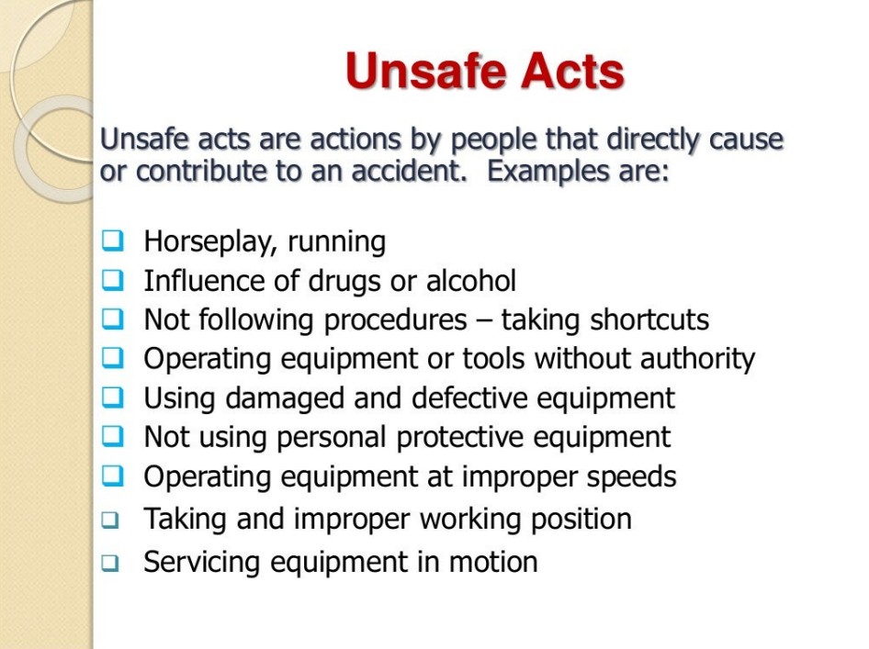

Slide 5
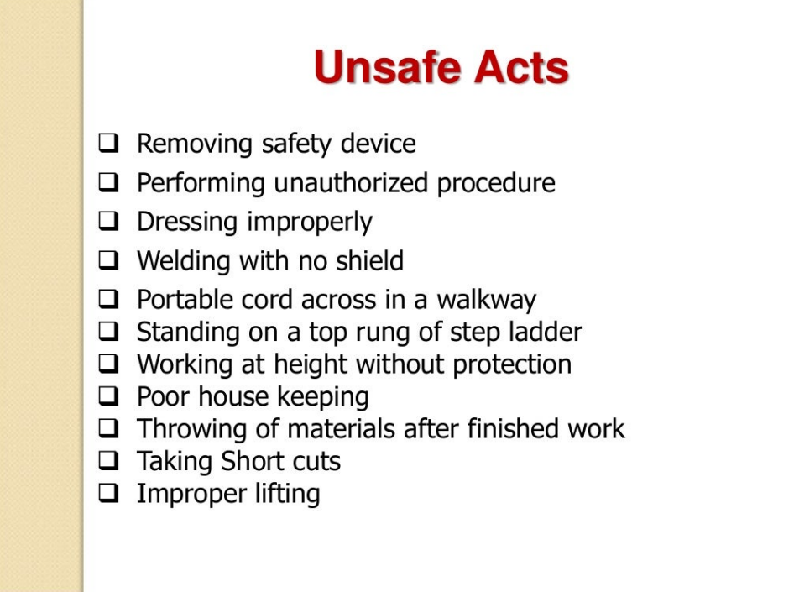

Slide 6
To prevent unsafe act type accidents
Think about how to do the task safely prior to engaging in the work.
Warn co-workers of hazards. When a custodian is mopping the floor, use warning signs at conspicuous locations to warn pedestrian traffic. If something spills on the floor, warn co-workers of the hazard until the spill is cleaned. If equipment is damaged or defective, warn coworkers by taking the equipment out of service or by lockout/tagout.
Comply with all work rules and procedures.
If you are not trained to use a piece of equipment, don’t use it.
Don’t rush your work or take shortcuts. Don’t try to complete a ten minute task in two minutes. Chances are that something will go wrong.

Slide 7
To prevent unsafe act type accidents
Use all equipment, tools, and material in the appropriate and intended manner. Don’t use a chair as a ladder.
Use proper lifting technique, a lifting device, or get assistance.
Use appropriate personal protective equipment.
Stop and mentor employees engaged in unsafe acts.
Supervisors should be vigilant for unsafe acts

Slide 8
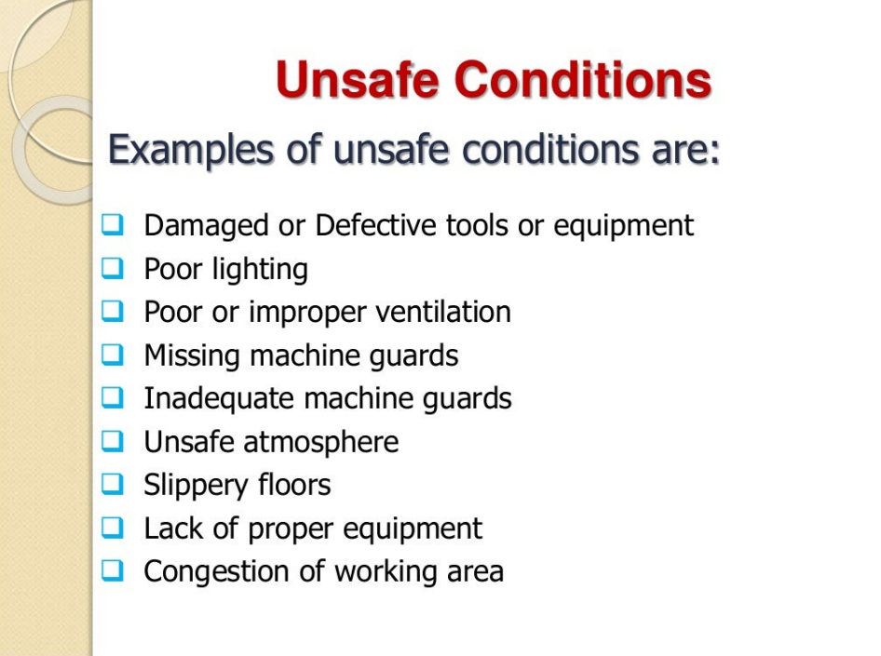

Slide 9
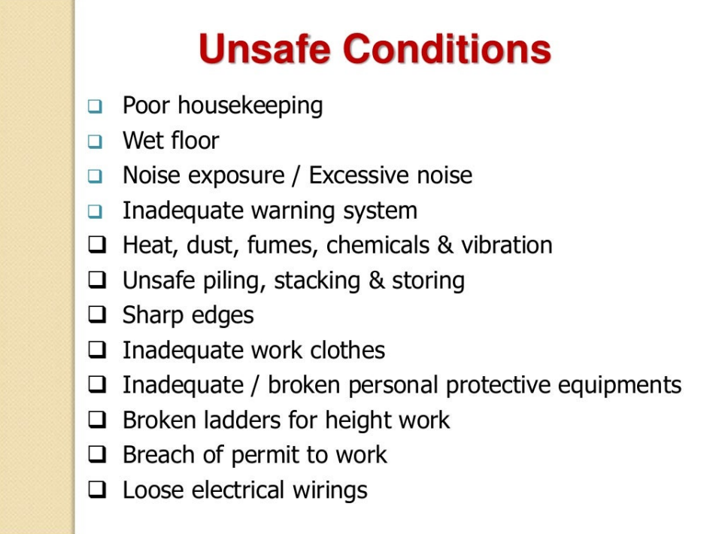

Slide 10
To prevent unsafe condition type accidents
Think about how to do the task safely prior to engaging in the work. Ensure that you have all appropriate equipment, tools and material to safely do the job. If you don’t have the correct equipment, e.g., personal protective equipment, tell your supervisor before starting the work.
Inspect all equipment, tools and material before use. Make certain the item is in good working condition and is appropriate for the task.
Make certain that you have enough space to complete the job. Many injuries are caused because employees didn’t have sufficient room to do a job.
Injuries occur everyday because employees choose not to say anything about known hazards. Employees identifying unsafe conditions should cease their activity and report the condition to their immediate supervisor for corrective action.

Slide 11
Reportable accidents
Reportable accidents mean workplace accidents that are required to be reported to an occupational safety officer of the Labour Department.
For any accident that results in an employee being incapacitated from working for at least three days, the accident should be reported in writing within seven days after the date of the accident.
For more serious accidents that involve death or serious bodily injury to an employee, the employer has to notify the Labour Department within 24 hours after the accident.

Slide 12
Dangerous occurrence
Dangerous occurrences are certain unintended, specified events, which may not result in a reportable injury, but which do have the potential to cause significant harm.
Dangerous occurrences usually include incidents involving:
o Lifting equipment o Pressure systems
o Overhead electric lines o Electrical incidents causing explosion or fire
o Breathing apparatus o Explosions, biological agents
o Diving operations o Radiation generators and radiography
o Collapse of scaffolding o Train collisions
o Wells o Pipelines or pipeline works

